Slide 1
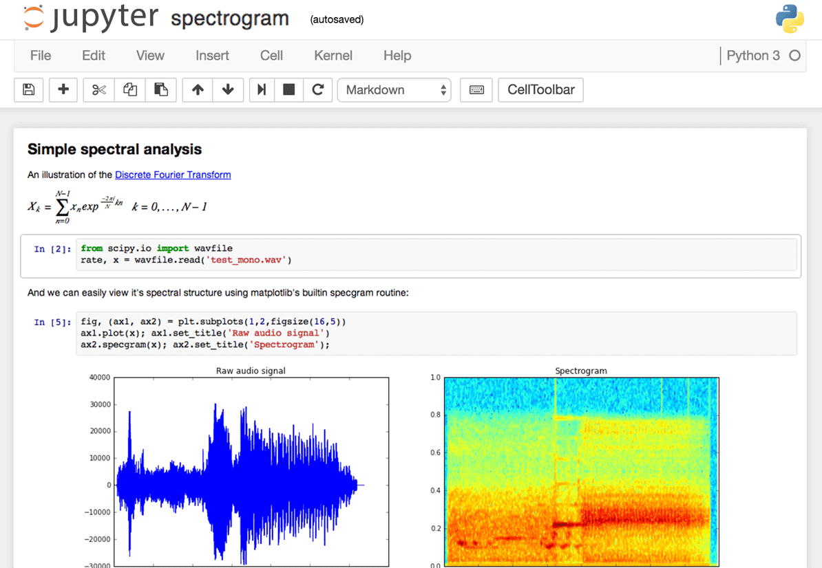
Anaconda &
Jupyter Notebook
src: https://www.dataquest.io/blog/content/images/interface-screenshot.png

Slide 2
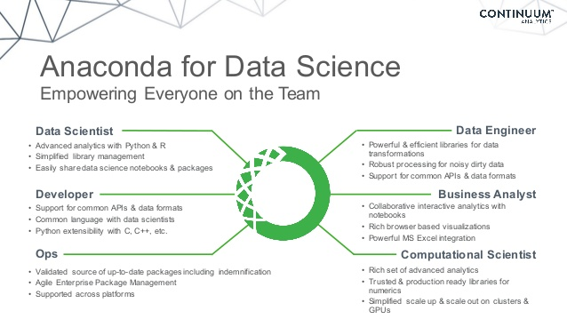
Anaconda
❑ Anaconda is an open source distribution of Python for
large-scale data processing
predictive analytics
scientific computing
Reference: https://en.wikipedia.org/wiki/Anaconda_(Python_distribution)
Src: https://image.slidesharecdn.com/201511distributedsystemswebinar-151112174420-lva1-app6891/95/distributed-computing-on-your-cluster-with-anaconda-webinar-2015-7-638.jpg?cb=1455728952

Slide 3
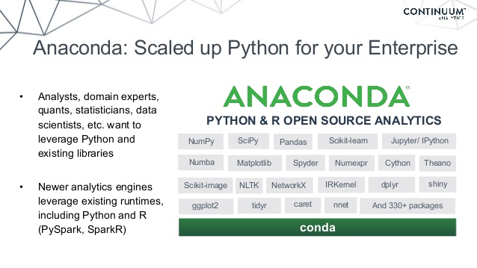
Anaconda
❑ Anaconda includes…
Latest version of Python
Useful libraries and packages for scientific computing (NumPy, Pandas, Scikit-learn, …)
Python development environment (Jupyter Notebook, qtconsole, Spyder, …)
Package management tool (conda, pip, …)
❑ So you don’t have to install them one by one!
Src: https://image.slidesharecdn.com/201511distributedsystemswebinar-151112174420-lva1-app6891/95/distributed-computing-on-your-cluster-with-anaconda-webinar-2015-11-638.jpg?cb=1455728952

Slide 4
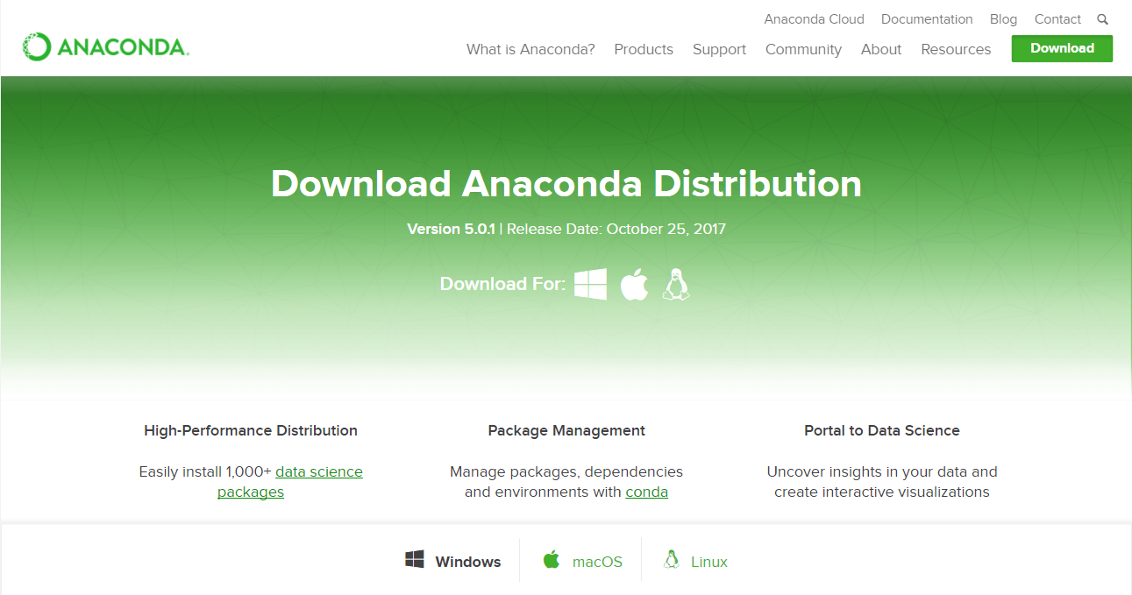
Installation
❑ Download latest version of Anaconda and install
https://www.anaconda.com/download/
❑ TIP: It is useful to remember where Anaconda is installed (i.e., directory)
In some cases, one has to access the directory (e.g., for path settings)
Src: https://www.anaconda.com/download/

Slide 5
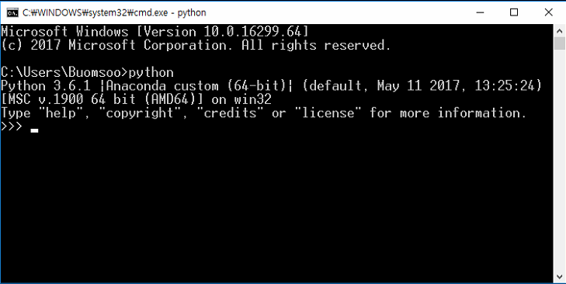
Installation
❑ If installation is finished, run Python for sanity check
In cmd or terminal, type “python” and press Enter
If it is not working properly, check path environment variable

Slide 6
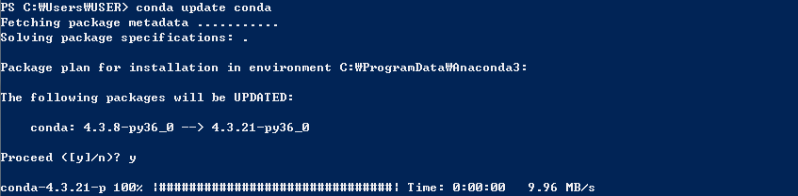
Conda
❑ Updating Conda
Use below command to update Conda to latest version
Type “y” and press enter to proceed
conda update conda

Slide 7
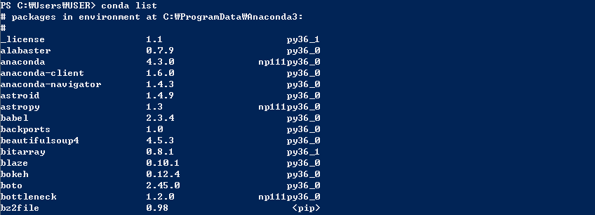
Conda
❑ Packages in Conda
To view all packages installed with Conda, use below command
conda list

Slide 8
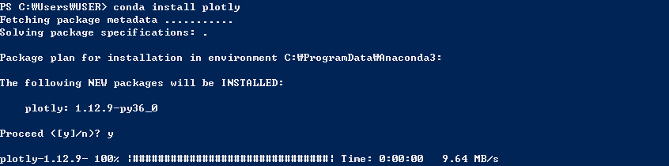
Conda
❑ Installing packages
To install new package is piece of cake
To install package named “plotly,”
conda install [package_name]
conda install [package_name]
conda install plotly

Slide 9
Conda
❑ Installing packages
However, some packages are not installable via Conda
Then use pip command, or manually download & install
To install pygame via pip command,
pip install [package_name]
pip install pygame

Slide 10
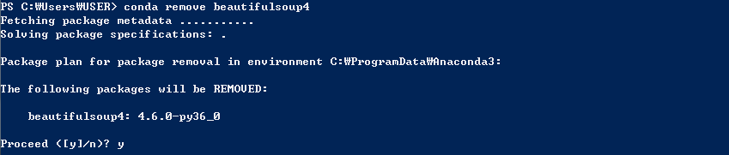
Conda
❑ Removing packages
Packages can be removed by Conda
To remove package beautifulsoup4,
conda remove [package_name]
conda remove beautifulsoup4

Slide 11
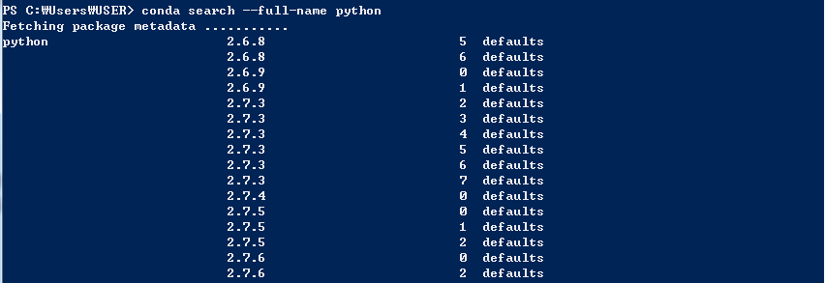
Conda
❑ Managing Python as a Package
Interestingly, Python is just another package included in Conda
So, Python can be installed, removed, and updated as other packages
To check which Python versions are available,
conda search -–full-name python

Slide 12
Conda
❑ Managing Python as a Package
Assume that you are Python 3.6 is installed (via Conda), and you want to use Python 2.7 (legacy version)
Then, you can create Conda environment with below command
For instance, to set environment name “py27” and use version 2.7,
conda create -–name [env_name] python=[version]
conda create -–name py27 python=2.7

Slide 13
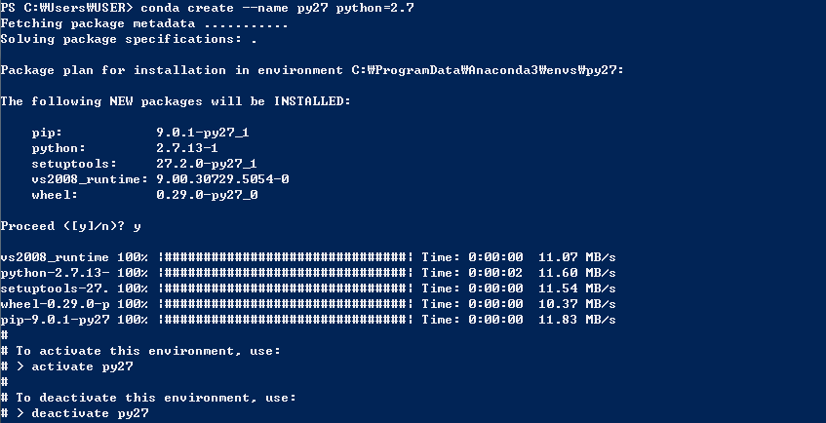
Conda
❑ Managing Python as a Package

Slide 14
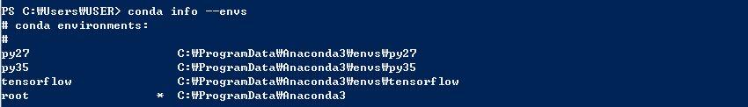
Conda
❑ Managing Python as a Package
Checking added environments
conda info --envs

Slide 15

Conda
❑ Managing Python as a Package
Activating created environment
Windows
MAC OSX
activate [env_name]
source activate [env_name]

Slide 16
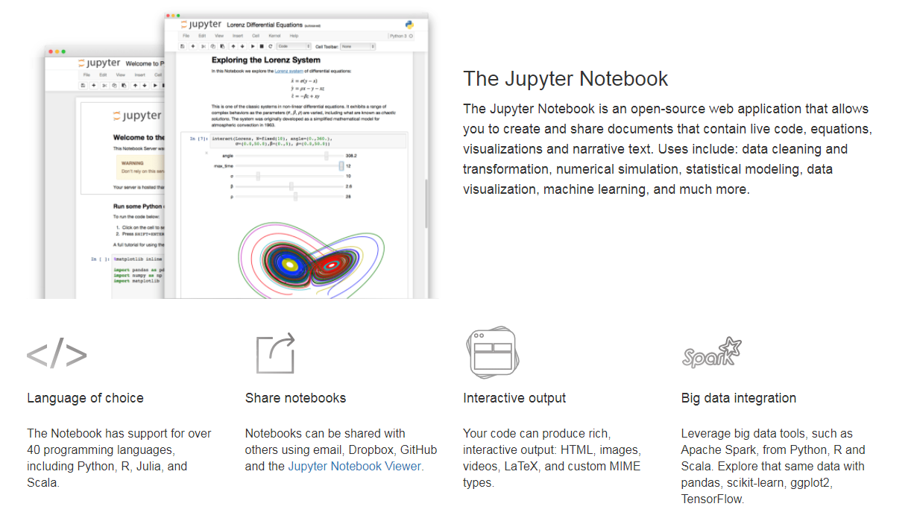
Jupyter Notebook
❑ Jupyter Notebook is an open-source web application that allows creating and sharing documents that contain live code, equations, visualizations, and narrative text
Jupyter Notebook is included in latest version of Anaconda
Reference: http://jupyter.org/
Src: http://jupyter.org/

Slide 17
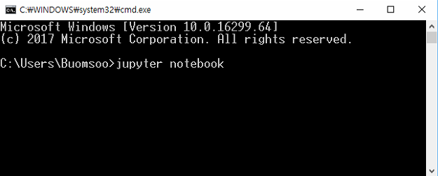
Jupyter Notebook
❑ Running Jupyter Notebook
In cmd or terminal, type “jupyter notebook” and press enter

Slide 18
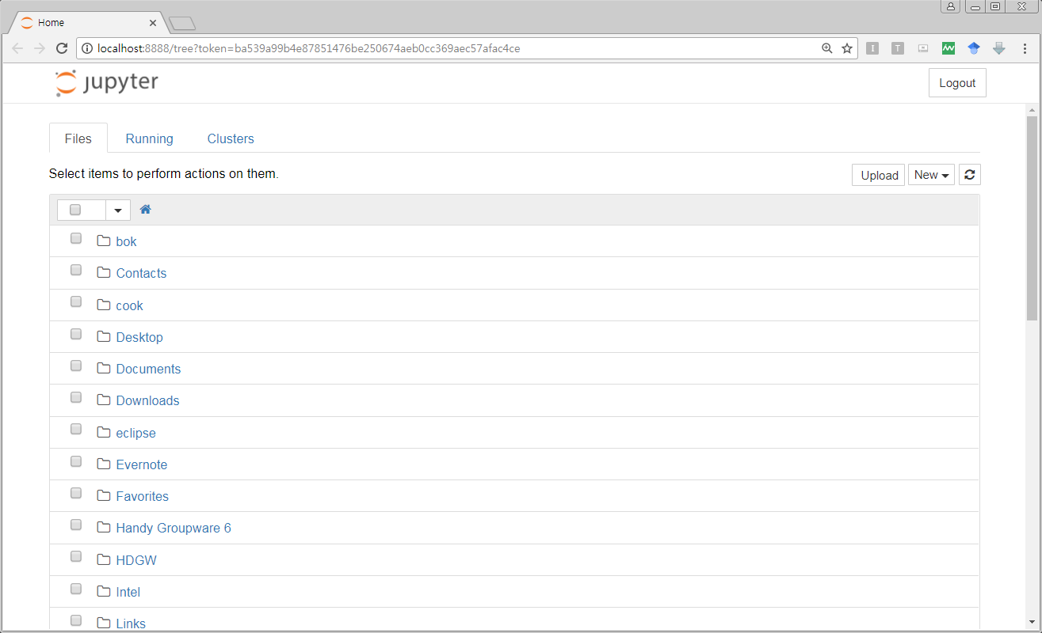
Jupyter Notebook
❑ Running Jupyter Notebook
In default browser (Chrome, Safari, Explorer, …), elements in home directory of your PC will be displayed

Slide 19
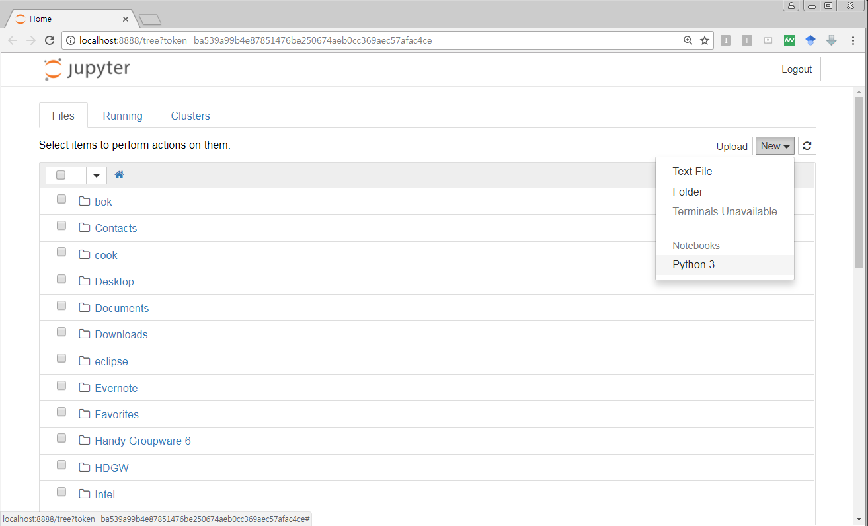
Jupyter Notebook
❑ Creating Jupyter Notebook document
Select [New] button in upper right section, and press [Python 3]

Slide 20
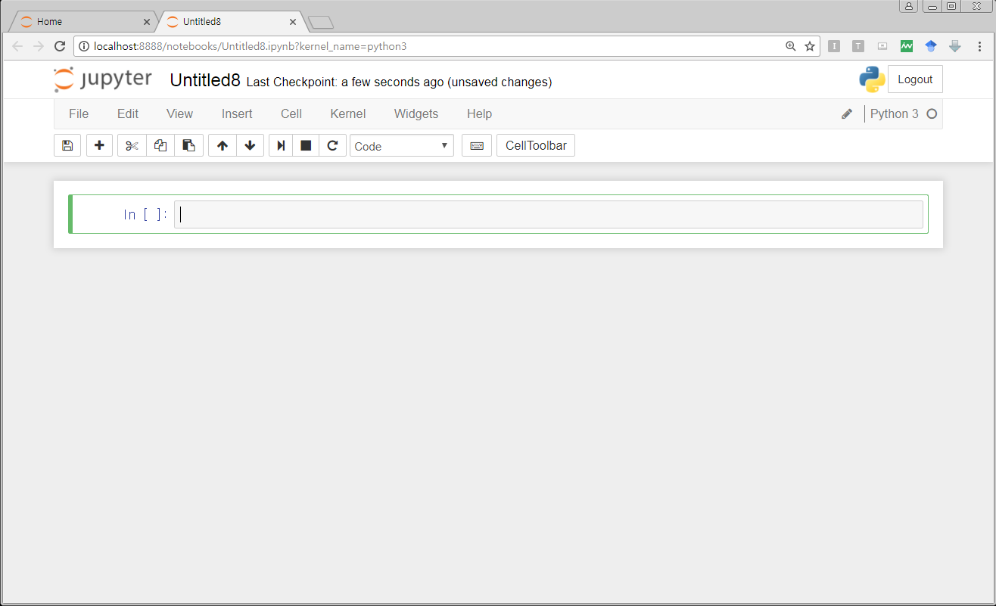
Jupyter Notebook
❑ Creating Jupyter Notebook document
Untitled Jupyter Notebook document will be created
File extension of Jupyter Notebook is “.ipynb”

Slide 21
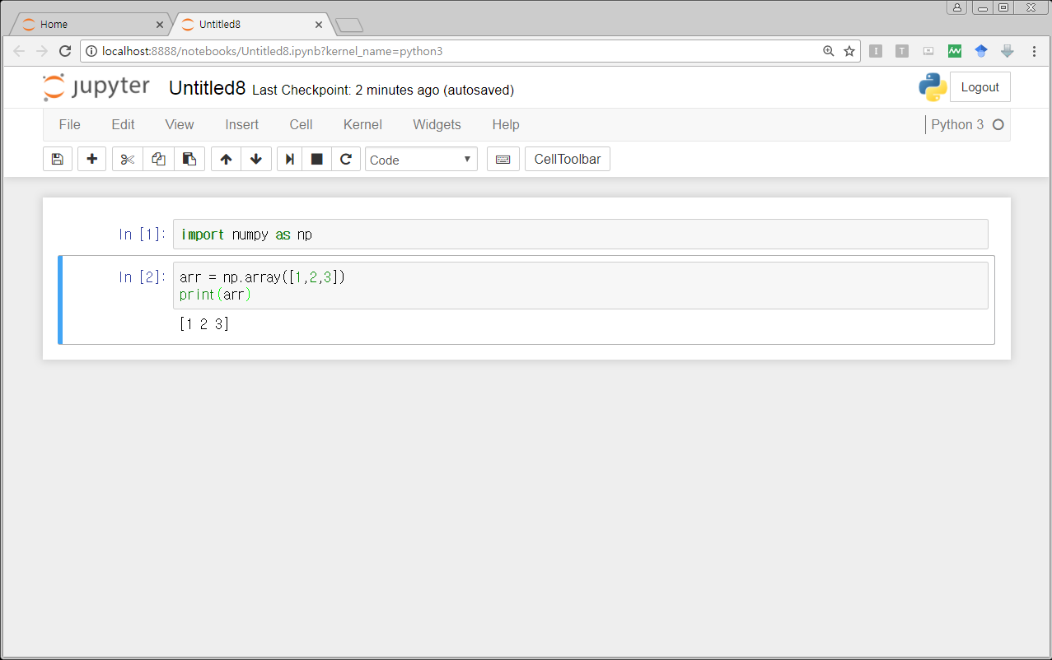
Jupyter Notebook
❑ Creating Jupyter Notebook document
Now you could create code blocks and type code lines and run them!

Slide 22
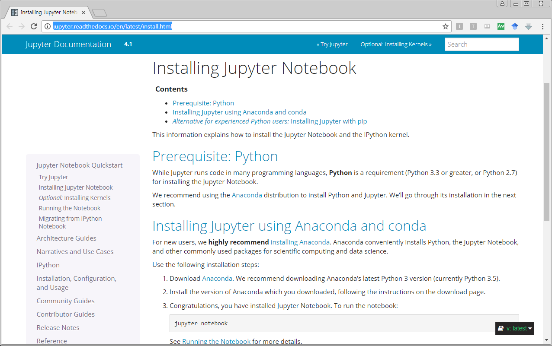
Jupyter Notebook
❑ Jupyter Notebook Documentation
For more information, refer to Jupyter Notebook official documentation
http://jupyter.readthedocs.io/en/latest/install.html

